Slide 1
Routing Basics
Lecture 23
CT4005NI - Computer Hardware and Software
Architectures

Slide 2
Router as a Computer
Computers that specialize in sending packets over the data network.
They are responsible for interconnecting networks by selecting the best path for a packet to travel and forwarding packets to their destination.
Routers have many of the same hardware and software components that are found in other computing including:
CPU
RAM
ROM
Operating System

Slide 3
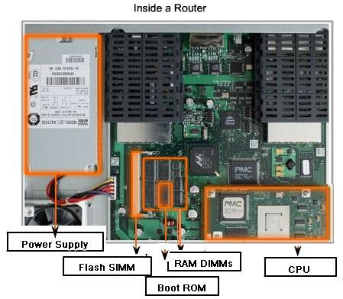
Router Hardware
.

Slide 4
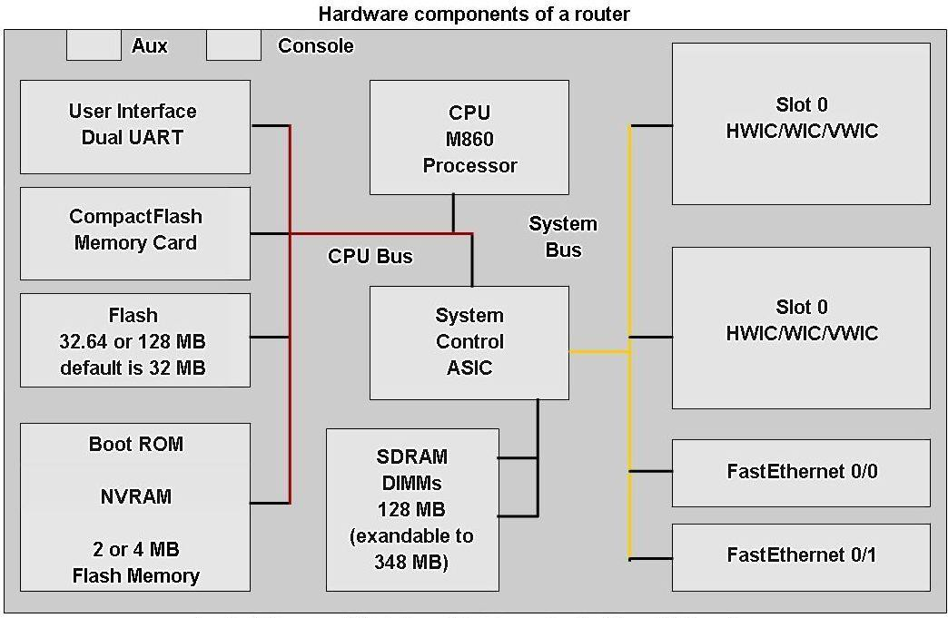
Router as a Computer
Router components

Slide 5
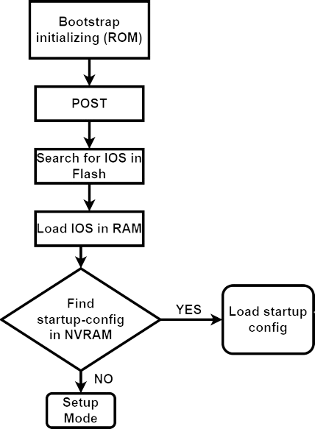
Router Boot Process
Major phases in Cisco router Boot Process
Initialize the bootstrap in ROM chip
Run POST
Search for IOS in Flash
Load OS
Find startup-config.txt file in NVRAM

Slide 6
Router as a Computer (CPU)
CPU - Executes operating system instructions
such as system initialization, routing functions, and switching functions.

Slide 7
Router as a computer (RAM)
RAM stores the instructions and data needed to be executed by the CPU. RAM is used to store these components:
–Operating System: The Cisco IOS (Internetwork Operating System) is copied into RAM during boot up.
–Running Configuration File: This is the configuration file that stores the configuration commands that the router IOS is currently using. The file is running-config.txt. This is shown when we run
router# show running-config

Slide 8
RAM continue
–IP Routing Table: This file stores information about directly connected and remote networks. It is used to determine the best path to forward the packet. We can see it by using
router# show ip route
–ARP Cache: This cache contains the IPv4 address to MAC address mappings, similar to the ARP cache on a PC. The ARP cache is used on routers that have LAN interfaces such as Ethernet interfaces.
–Packet Buffer: Packets are temporarily stored in a buffer when received on an interface or before they exit an interface.
Note: RAM is volatile memory and loses its content when the router is powered down or restarted.

Slide 9
Router as a Computer (ROM)
Holds diagnostic software used when router is powered up. Stores the router’s bootstrap program.
ROM is a form of permanent storage.
ROM uses firmware, which is software that is embedded inside the integrated circuit.
Firmware includes the software that does not normally need to be modified or upgraded, such as the boot up instructions.
ROM does not lose its contents when the router loses power or is restarted.

Slide 10
Router as a Computer (Flash)
Contains the operating system (Cisco IOS)
In most models of Cisco routers, the IOS is permanently stored in flash memory and copied into RAM during the bootup process, where it is then executed by the CPU.
Flash consists of SIMMs or PCMCIA cards, which can be upgraded to increase the amount of flash memory.

Slide 11
Router as a Computer (NVRAM)
Non-volatile RAM (NVRAM) - Stores startup configuration. This may include IP addresses (Routing protocol, Hostname of router)
NVRAM (Nonvolatile RAM) does not lose its information when power is turned off.
NVRAM is used by the Cisco IOS as permanent storage for the startup-config.txt file.
When commands are executed it changes in running-config.txt file but as running-config.txt is in RAM its contents gets lost after power loss.
So, we should save it to startup-config.txt
Command to save:
router# write
OR
router# copy running-config startup-config

Slide 12
Internetwork Operating System (IOS)
The operating system software used in Cisco routers is known as Cisco Internetwork Operating System (IOS).
Cisco IOS is a multitasking operating system that is integrated with routing, switching, internetworking, and telecommunications functions.
Although the Cisco IOS may appear to be the same on many routers, there are many different IOS images.
Although some routers provide a graphical user interface (GUI), the command line interface (CLI) is a much more common method of configuring Cisco routers.

Slide 13
Interfaces in a Router
Interfaces - There exist multiple physical interfaces that are used to connect network. Examples:
Router Interface
Management interface

Slide 14
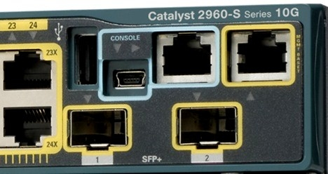
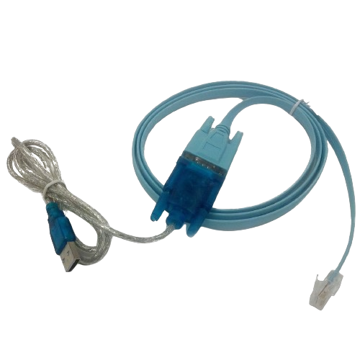
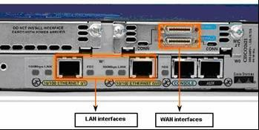
Management Ports
Routers have physical connectors that are used to manage the router. These connectors are known as management ports.
They are also called Console ports.
This ports are not used to forward packets.
Roll over cable or console cable is used to connect laptop to the computer.

Slide 15
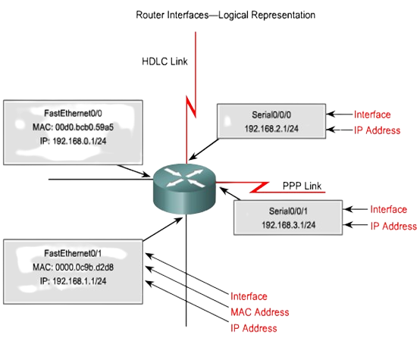
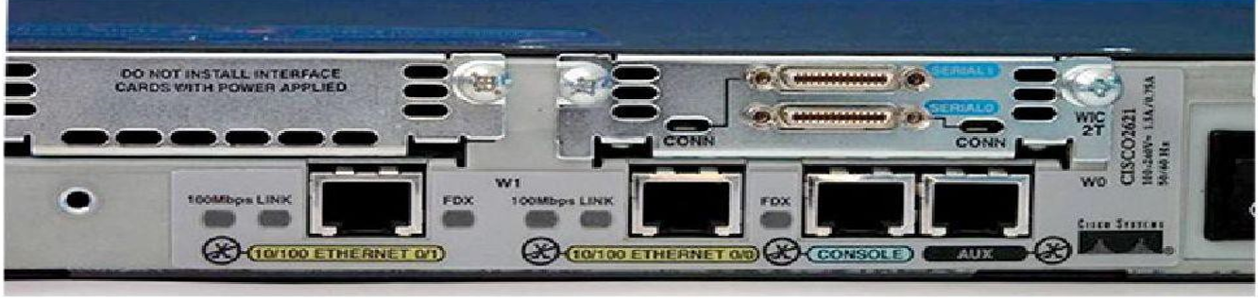
Router Interfaces
Router interface is a physical connector that enables a router to send or receive packets in the router.
Each interface is a different network (subnet).

Slide 16
Router Interfaces
Generally routers have two connections:
WAN connection (connection to ISP)
LAN connection
Types of router interfaces:
Ethernet
DSL
Serial

Slide 17
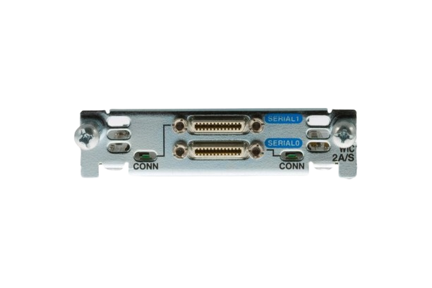
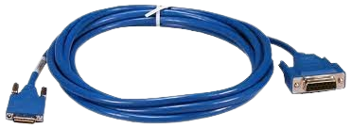
Serial Interface
▪ Serial interfaces on Cisco routers are primarily used for connecting to wide area networks (WANs) or other networking devices over serial communication links.
It uses IP addressing for Layer 3 address but does not require MAC-address.
It uses different protocols to communicate like
PPP (Point-to-Point)
HDLC (High – Level Data Link)
The maximum speed is 53 Mbps

Slide 18
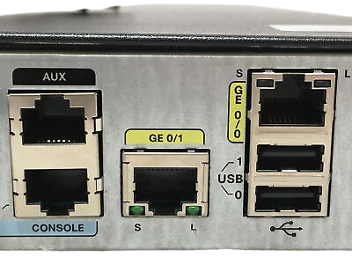
Ethernet interface
It uses RJ45 connector to connect devices.
It was mainly used for LAN connectivity but nowadays it has replaced serial interfaces and is used for both LAN and WAN.
It uses IP address as Layer 3 header and MAC-address as Layer-2 header.
ARP is used to find MAC-address.
Its types are :
Ethernet (10 Mbps)
Fast Ethernet (100 Mbps)
Gigabit Ethernet (1 Gbps)
10 Gigabit Ethernet (10 Gbps ) and so on.

Slide 19
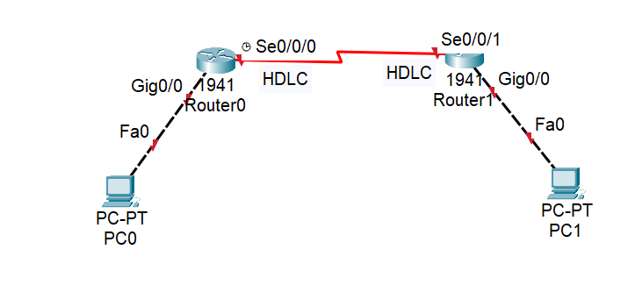
Router changes Layer 2 encapsulation
If a router has to go from one type of encapsulation to another eg: if a packet is to go from serial interface to ethernet interface router changes Layer 2 encapsulation of the packet.
Router also changes source MAC and destination MAC on each hop.

Slide 20
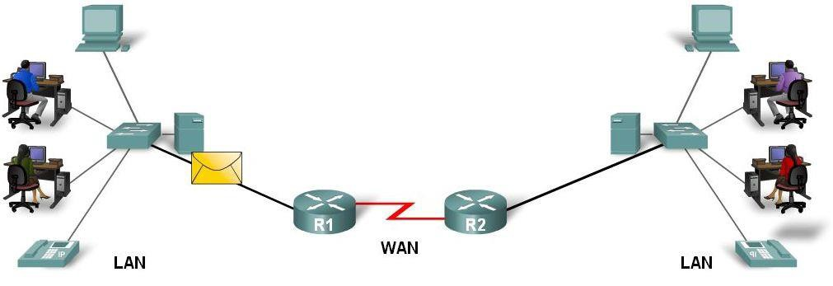
Routers determine the path (route)
▪ Router connects multiple networks ,this means that it has multiple interfaces that each belong to a different IP network.
▪When a router receives an IP packet on one interface, it determines which interface to use to forward the packet onto its destination.
▪The interface that the router uses to forward the packet may be the network of the final destination of the packet (the network with the destination IP address of this packet), or it may be a network connected to another router that is used to reach the destination network.

Slide 21
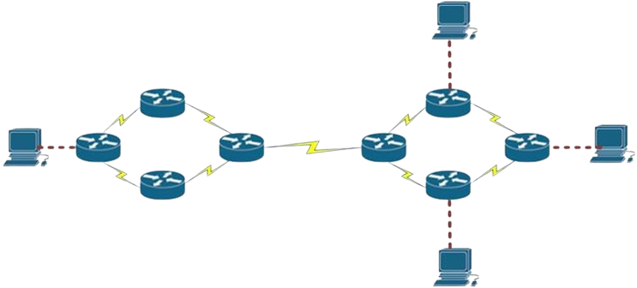
Router determines the best path
If a router has two or more routes (paths) to the destination, router chooses the best path to the destination using Administrative Distance (AD) and algorithm used by routing protocol.

Slide 22
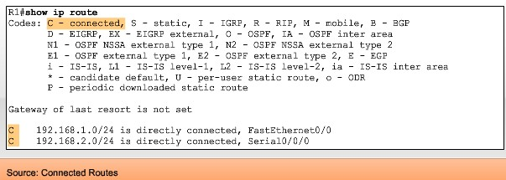
Primary Role of a Router
The primary responsibility of a router is to direct packets destined for local and remote networks by:
–Determining the best path to send packets
–Forwarding packets toward their destination
The router uses its routing table to determine the best path to forward the
packet.
–When the router receives a packet, it examines its destination IP address and searches for the best match with a network address in the router's routing table.
–The routing table also includes the interface to be used to forward the packet. Once a match is found, the router encapsulates the IP packet into the data link frame of the outgoing or exit interface, and the packet is then forwarded toward its destination.

Slide 23
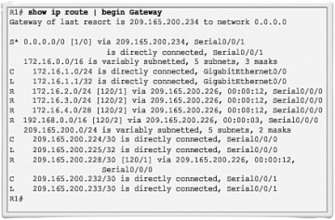
Routing Table
When a packet is received by the router, the router first examines the packet’s destination address.
Then the router looks for the destination network in its routing table.
If there is an entry in the routing table then router forwards according to the table else drops the packet.

Slide 24
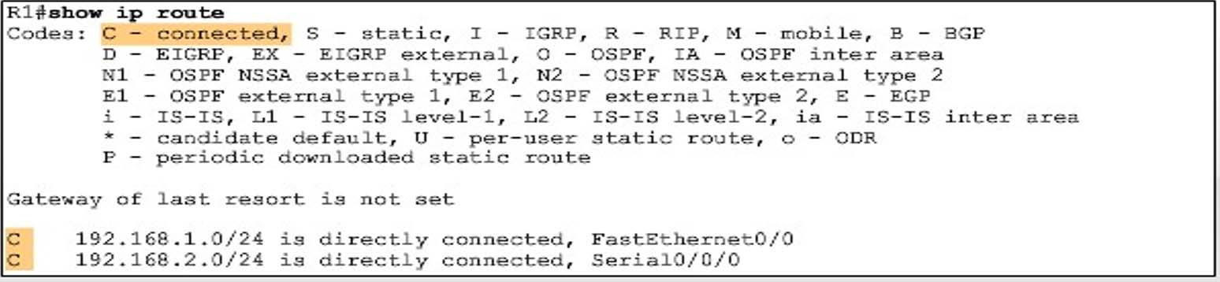
Routing Table
Routing Table is stored in RAM and contains information:
▪Directly connected networks - this occurs when a device is connected to another router interface
▪Remotely connected networks - this is a network that is not directly connected to a particular router
▪network/next hop associations - about the networks include source of
information, network address & subnet mask, and Ip address of next-hop router
Show ip route command is used to view a routing table

Slide 25
Routing
Routers obtain routes through various mechanisms, including static routes and dynamic routing protocols.
In static route, network administrators define the route themselves defining the exit interface or next hop association.
router(config)# ip route <dst network id> <dst subnet mask> <next hop address>
router(config)# ip route 192.168.2.0 255.255.255.0 10.1.1.1

Slide 26
Dynamic Routing Protocols
In dynamic route, there are many routing protocols that have their set of rules through which they automatically gets routes by exchanging with their neighbour routers.
The different dynamic routing protocols are:
RIP (Routing Information Protocol)
OSPF (Open Shortest Path First)
EIGRP (Enhanced Interior Gateway Routing Protocol)
BGP (Border Gateway Protocol)

Slide 27
End of Lecture 23

